Slide 1

Vežba 12
Razmenjivači toplote
Termodinamika sa termotehnikom

Slide 2
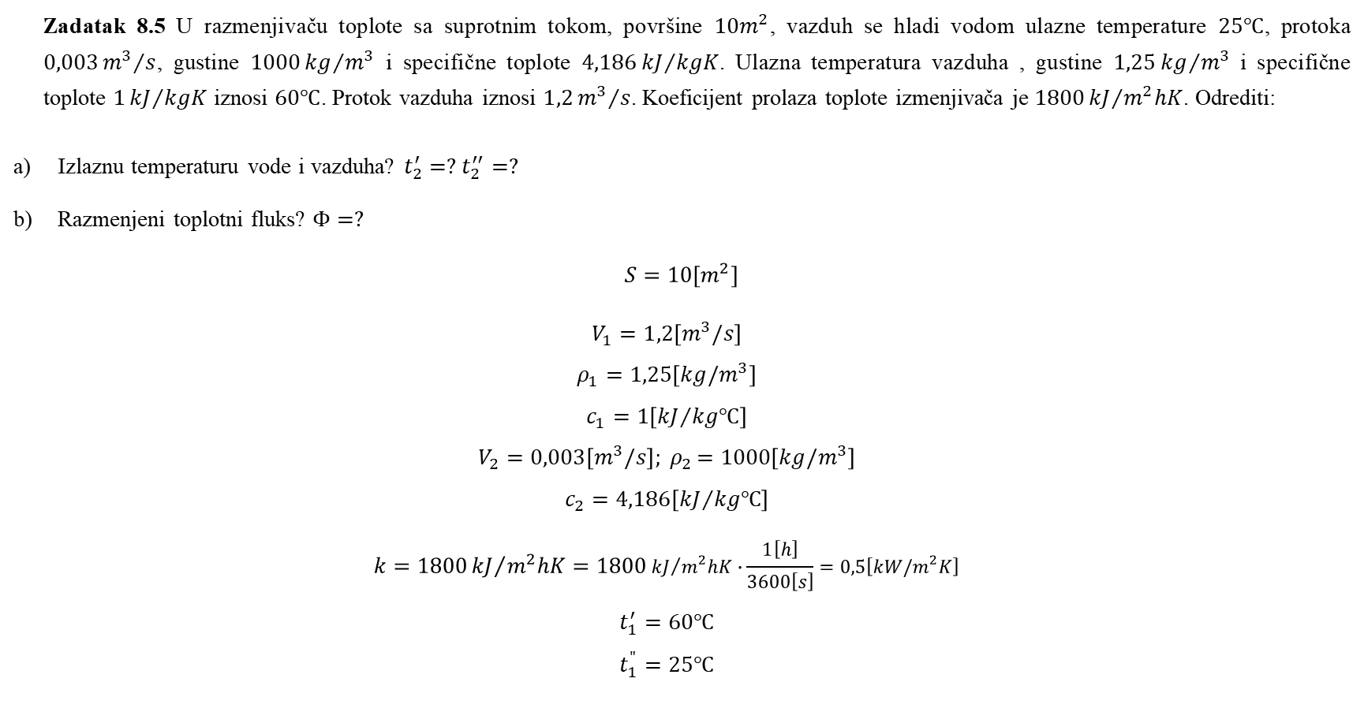
Zadatak 8.5 U razmenjivaču toplote sa suprotnim tokom, površine $10m^{2}$, vazduh se hladi vodom ulazne temperature $25℃$, protoka $0,003{m^{3}}/s$, gustine $1000{kg}/{m^{3}}$ i specifične toplote $4,186{kJ}/{kgK}$. Ulazna temperatura vazduha , gustine $1,25{kg}/{m^{3}}$ i specifične toplote $1{kJ}/{kgK}$ iznosi $60℃$. Protok vazduha iznosi $1,2{m^{3}}/s$. Koeficijent prolaza toplote izmenjivača je $1800{kJ}/{m^{2}hK}$. Odrediti:
Izlaznu temperaturu vode i vazduha? $t_{2}^{′}=?$ $t_{2}^{′′}=?$
Razmenjeni toplotni fluks? $Φ=?$
$$S=10\left[m^{2}\right]$$
$$V_{1}=1,2\left[m^{3}/s\right]$$
$$ρ_{1}=1,25\left[kg/m^{3}\right]$$
$$c_{1}=1\left[{kJ}/{kg℃}\right]$$
$$V_{2}=0,003\left[m^{3}/s\right]{; ρ}_{2}=1000\left[kg/m^{3}\right]$$
$$c_{2}=4,186\left[{kJ}/{kg℃}\right]$$
$$k=1800{kJ}/{m^{2}hK}=1800{kJ}/{m^{2}hK}∙\frac{1\left[h\right]}{3600\left[s\right]}=0,5\left[kW/m^{2}K\right]$$
$$t_{1}^{′}=60℃$$
$$t_{1}^{"}=25℃$$

Slide 3

$$∆t^{′}=\left(t_{1}^{′}−t_{1}^{"}\right)φ$$
$$∆t^{"}=\left(t_{1}^{′}−t_{1}^{"}\right)\frac{W_{1}}{W_{2}}φ$$
$$W_{1}=V_{1}ρ_{1}c_{1}$$
$${W_{2}=V}_{2}ρ_{2}c_{2}$$
$$W_{1}=1,2\left[{m^{3}}/s\right]∙1,25\left[{kg}/{m^{3}}\right]∙1\left[{kJ}/{kgK}\right]=1,5\left[{kW}/K\right]$$
$$W_{2}=0,003\left[{m^{3}}/s\right]∙1000\left[{kg}/{m^{3}}\right]∙4,186\left[{kJ}/{kgK}\right]=12,58\left[{kW}/K\right]$$
$$\frac{W_{1}}{W_{2}}=0,12$$
$$\frac{kS}{W_{1}}=\frac{0,5\left[{kW}/{m^{2}K}\right]∙10\left[m^{2}\right]}{1,5\left[{kW}/K\right]}=3,3$$

Slide 4

$$φ=\frac{1−e^{−\left(1−\frac{W_{1}}{W_{2}}\right)\frac{kS}{W_{1}}}}{{1−\frac{W_{1}}{W_{2}}e}^{−\left(1−\frac{W_{1}}{W_{2}}\right)\frac{kS}{W_{1}}}}=\frac{1−e^{−\left(1−0,12\right)3,3}}{{1−0,12∙e}^{−\left(1−0,12\right)3,3}}=0,968$$
$$∆t^{′}=\left(t_{1}^{′}−t_{1}^{"}\right)φ=\left(60−25\right)0,968=33,88\left[℃\right]$$
$$t_{2}^{′}=t_{1}^{′}−∆t^{′}=60−33,88=26,12\left[℃\right]$$
$$∆t^{′′}=\left(t_{1}^{′}−t_{1}^{"}\right)\frac{W_{1}}{W_{2}}φ=\left(60−25\right)∙0,12∙0,96=4,066$$
$$t_{2}^{"}=t_{1}^{"}+\left(t_{1}^{′}−t_{1}^{"}\right)\frac{W_{1}}{W_{2}}φ=29,066\left[℃\right]$$
$$Φ=W_{1}∆t^{′}=1,5\left[{kW}/K\right]∙33,88\left[℃\right]=50,82\left[kW\right]$$

Slide 5
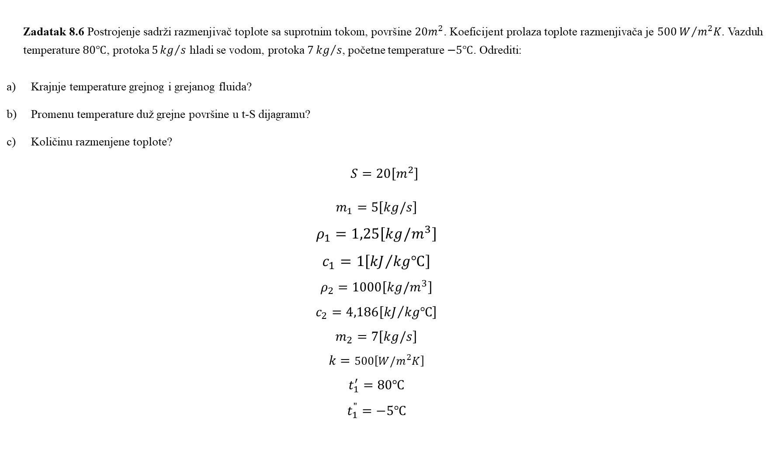
Zadatak 8.6 Postrojenje sadrži razmenjivač toplote sa suprotnim tokom, površine $20m^{2}$. Koeficijent prolaza toplote razmenjivača je $500W/{m^{2}K}$. Vazduh temperature $80℃$, protoka $5{kg}/s$ hladi se vodom, protoka $7{kg}/s$, početne temperature $−5℃$. Odrediti:
Krajnje temperature grejnog i grejanog fluida?
Promenu temperature duž grejne površine u t-S dijagramu?
Količinu razmenjene toplote?
$$S=20\left[m^{2}\right]$$
$$m_{1}=5\left[kg/s\right]$$
$$ρ_{1}=1,25\left[kg/m^{3}\right]$$
$$c_{1}=1\left[{kJ}/{kg℃}\right]$$
$$ρ_{2}=1000\left[kg/m^{3}\right]$$
$$c_{2}=4,186\left[{kJ}/{kg℃}\right]$$
$$m_{2}=7\left[kg/s\right]$$
$$k=500\left[W/m^{2}K\right]$$
$$t_{1}^{′}=80℃$$
$$t_{1}^{"}=−5℃$$

Slide 6

$$∆t^{′}=\left(t_{1}^{′}−t_{1}^{"}\right)φ$$
$$∆t^{"}=\left(t_{1}^{′}−t_{1}^{"}\right)\frac{W_{1}}{W_{2}}φ$$
$$W_{1}=V_{1}ρ_{1}c_{1}=m_{1}c_{1}$$
$${W_{2}=V}_{2}ρ_{2}c_{2}=m_{2}c_{2}$$
$$W_{1}=5\left[{kg}/s\right]∙1\left[{kJ}/{kgK}\right]=5\left[{kW}/K\right]$$
$$W_{2}=7\left[{kg}/s\right]∙4,186\left[{kJ}/{kgK}\right]=29,3\left[{kW}/K\right]$$
$$\frac{W_{1}}{W_{2}}=0,17$$
$$\frac{kS}{W_{1}}=\frac{0,5\left[{kW}/{m^{2}K}\right]∙20\left[m^{2}\right]}{5\left[{kW}/K\right]}=2$$

Slide 7

$$φ=\frac{1−e^{−\left(1−\frac{W_{1}}{W_{2}}\right)\frac{kS}{W_{1}}}}{{1−\frac{W_{1}}{W_{2}}e}^{−\left(1−\frac{W_{1}}{W_{2}}\right)\frac{kS}{W_{1}}}}=\frac{1−e^{−\left(1−0,17\right)2}}{{1−0,17∙e}^{−\left(1−0,17\right)2}}=0,84$$
$$∆t^{′}=\left(t_{1}^{′}−t_{1}^{"}\right)φ=\left(80+5\right)0,84=71,4\left[℃\right]$$
$$t_{1}^{′}−t_{2}^{′}=71,4\left[℃\right]$$
$$t_{2}^{′}=t_{1}^{′}−71,4=8,6\left[℃\right]$$
$$∆t^{"}=\left(t_{1}^{′}−t_{1}^{"}\right)\frac{W_{1}}{W_{2}}φ=\left(80+5\right)0,17∙0,84=12,138\left[℃\right]$$
$$∆t^{"}=t_{2}^{"}−t_{1}^{"}⇒t_{2}^{"}=t_{1}^{"}+∆t^{"}=12,138−5=7,138\left[℃\right]$$
$$Φ=W_{1}∆t^{′}=5\left[{kW}/K\right]∙71,4\left[℃\right]=357\left[kW\right]$$

Slide 8
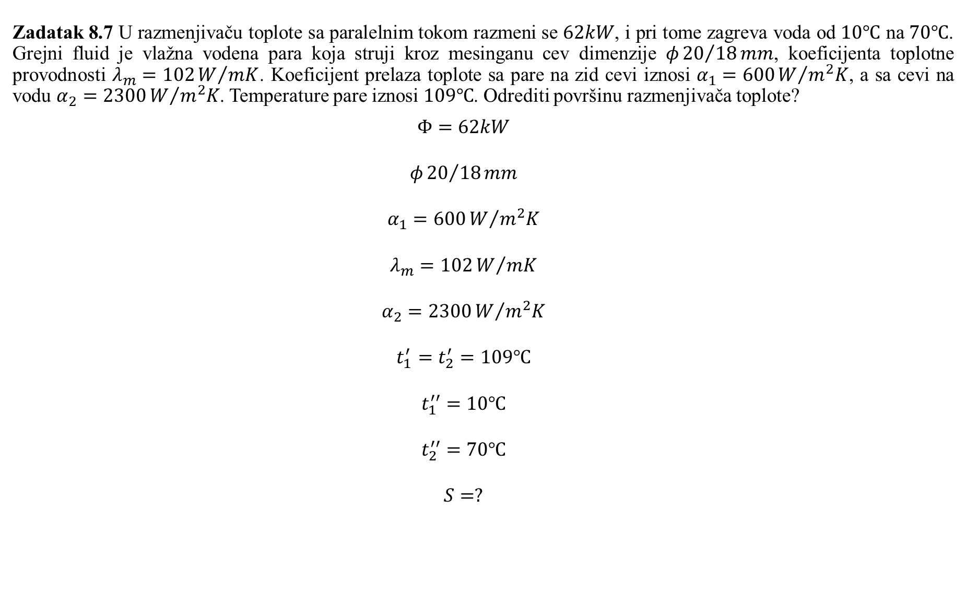
Zadatak 8.7 U razmenjivaču toplote sa paralelnim tokom razmeni se $62kW$, i pri tome zagreva voda od $10℃$ na $70℃$. Grejni fluid je vlažna vodena para koja struji kroz mesinganu cev dimenzije $φ{20}/{18}mm$, koeficijenta toplotne provodnosti $λ_{m}=102W/{mK}$. Koeficijent prelaza toplote sa pare na zid cevi iznosi $α_{1}=600W/{m^{2}K}$, a sa cevi na vodu $α_{2}=2300W/{m^{2}K}$. Temperature pare iznosi $109℃$. Odrediti površinu razmenjivača toplote?
$$Φ=62kW$$
$$φ{20}/{18}mm$$
$$α_{1}=600W/{m^{2}K}$$
$$λ_{m}=102W/{mK}$$
$$α_{2}=2300W/{m^{2}K}$$
$$t_{1}^{′}=t_{2}^{′}=109℃$$
$$t_{1}^{′′}=10℃$$
$$t_{2}^{′′}=70℃$$
$$S=?$$

Slide 9

$$S=\frac{Φ}{k∙∆t_{m}}$$
$$∆t_{m}=\frac{∆t_{1}−∆t_{2}}{\ln{\frac{∆t_{1}}{∆t_{2}}}}=\frac{\left(t_{1}^{′}−t_{1}^{"}\right)−\left(t_{2}^{′}−t_{2}^{"}\right)}{\ln{\frac{t_{1}^{′}−t_{1}^{"}}{t_{2}^{′}−t_{2}^{"}}}}$$
$$∆t_{m}=\frac{\left(109−10\right)−\left(109−70\right)}{\ln{\frac{\left(109−10\right)}{\left(109−70\right)}}}=64,4\left[℃\right]$$
$$\frac{1}{k}=\frac{1}{πd_{1}α_{1}}+\frac{1}{2πλ}\ln{\frac{d_{2}}{d_{1}}}+\frac{1}{πd_{2}α_{2}}$$
$$\frac{1}{k}=\frac{1}{π}\left(\frac{1}{0,018∙600}+\frac{1}{2∙102}\ln{\frac{20}{18}+}\frac{1}{0,02∙2300}\right)=0,036\left[{m^{2}K}/W\right]$$
$$k=27,78\left[W/{m^{2}K}\right]⇒S=\frac{62{∙10}^{3}\left[W\right]}{27,78\left[W/{m^{2}K}\right]∙64,4\left[℃\right]}=34,65\left[m^{2}\right]$$

Slide 10
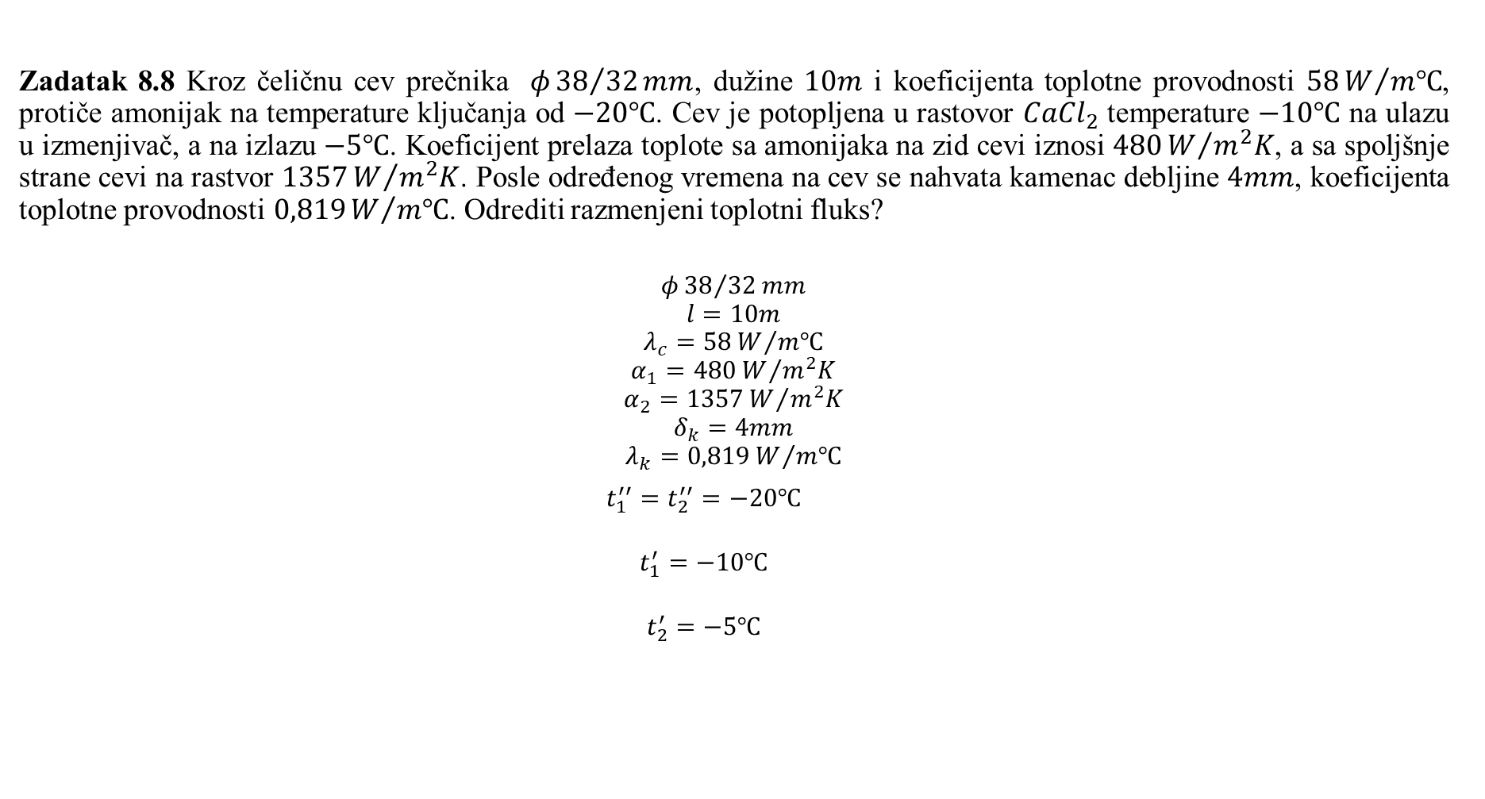
Zadatak 8.8 Kroz čeličnu cev prečnika $φ{38}/{32}mm$, dužine $10m$ i koeficijenta toplotne provodnosti $58W/{m℃}$, protiče amonijak na temperature ključanja od $−20℃$. Cev je potopljena u rastovor ${CaCl}_{2}$ temperature $−10℃$ na ulazu u izmenjivač, a na izlazu $−5℃$. Koeficijent prelaza toplote sa amonijaka na zid cevi iznosi $480W/{m^{2}K}$, a sa spoljšnje strane cevi na rastvor $1357W/{m^{2}K}$. Posle određenog vremena na cev se nahvata kamenac debljine $4mm$, koeficijenta toplotne provodnosti $0,819W/{m℃}$. Odrediti razmenjeni toplotni fluks?
$$φ{38}/{32}mm$$
$$l=10m$$
$$λ_{c}=58W/{m℃}$$
$$α_{1}=480W/{m^{2}K}$$
$$α_{2}=1357W/{m^{2}K}$$
$$δ_{k}=4mm$$
$$λ_{k}=0,819W/{m℃}$$
$$t_{1}^{′′}=t_{2}^{′′}=−20℃$$
$$t_{1}^{′}=−10℃$$
$$t_{2}^{′}=−5℃$$

Slide 11
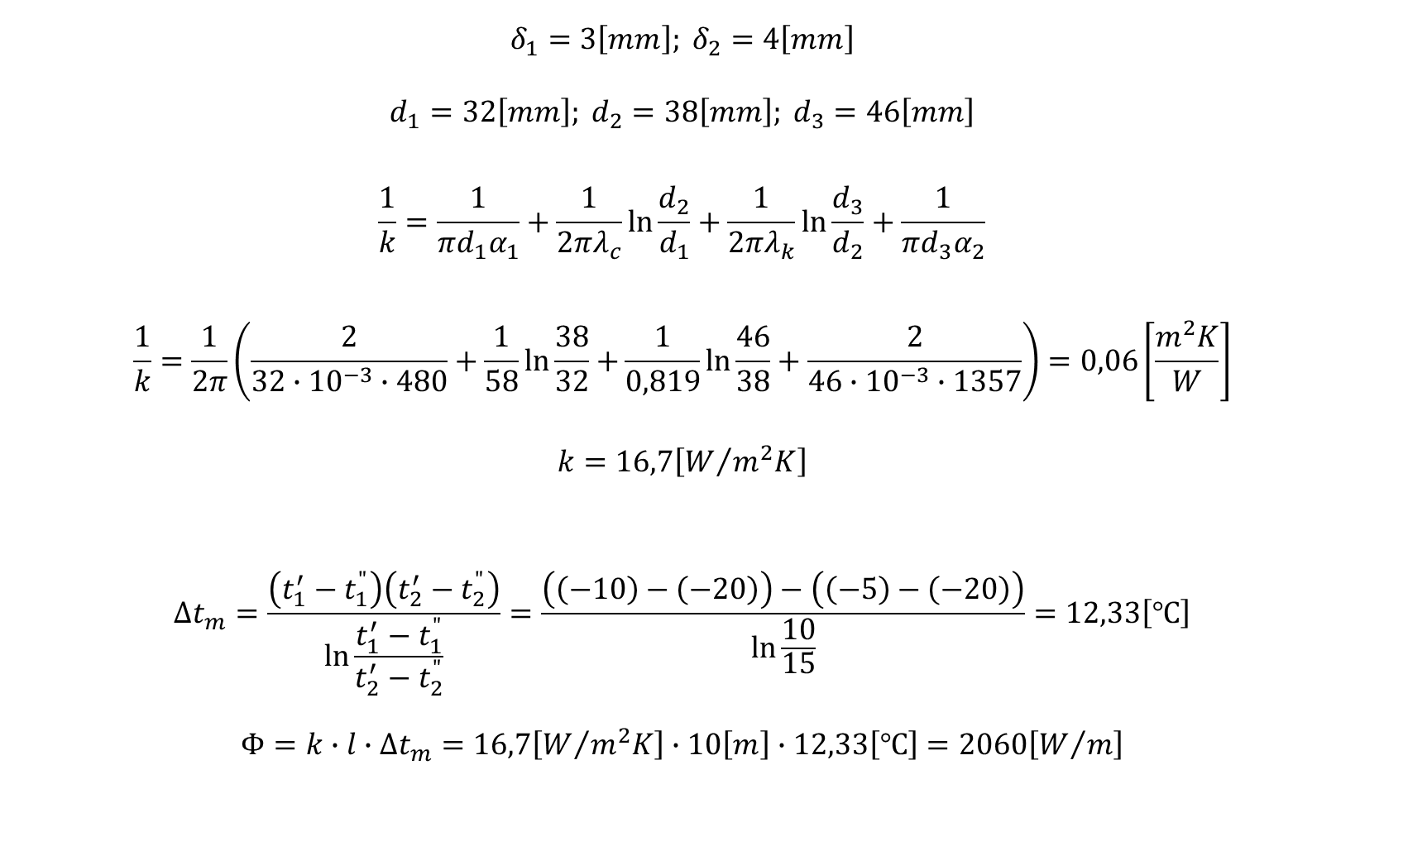
$$δ_{1}=3\left[mm\right]; δ_{2}=4\left[mm\right]$$
$$d_{1}=32\left[mm\right]; d_{2}=38\left[mm\right]; d_{3}=46\left[mm\right]$$
$$\frac{1}{k}=\frac{1}{πd_{1}α_{1}}+\frac{1}{2πλ_{c}}\ln{\frac{d_{2}}{d_{1}}}+\frac{1}{2πλ_{k}}\ln{\frac{d_{3}}{d_{2}}+\frac{1}{πd_{3}α_{2}}}$$
$$\frac{1}{k}=\frac{1}{2π}\left(\frac{2}{32∙{10}^{−3}∙480}+\frac{1}{58}\ln{\frac{38}{32}+}\frac{1}{0,819}\ln{\frac{46}{38}}+\frac{2}{46∙{10}^{−3}∙1357}\right)=0,06\left[\frac{m^{2}K}{W}\right]$$
$$k=16,7\left[W/{m^{2}K}\right]$$
$$∆t_{m}=\frac{\left(t_{1}^{′}−t_{1}^{"}\right)\left(t_{2}^{′}−t_{2}^{"}\right)}{\ln{\frac{t_{1}^{′}−t_{1}^{"}}{t_{2}^{′}−t_{2}^{"}}}}=\frac{\left(\left(−10\right)−\left(−20\right)\right)−\left(\left(−5\right)−\left(−20\right)\right)}{\ln{\frac{10}{15}}}=12,33\left[℃\right]$$
$$Φ=k∙l∙∆t_{m}=16,7\left[W/{m^{2}K}\right]∙10\left[m\right]∙12,33\left[℃\right]=2060\left[W/m\right]$$

Slide 12
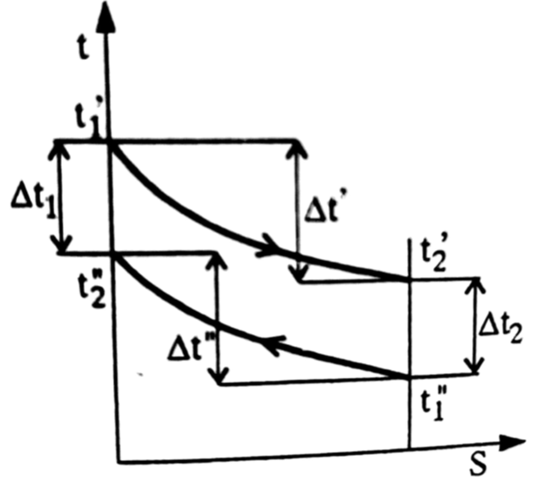
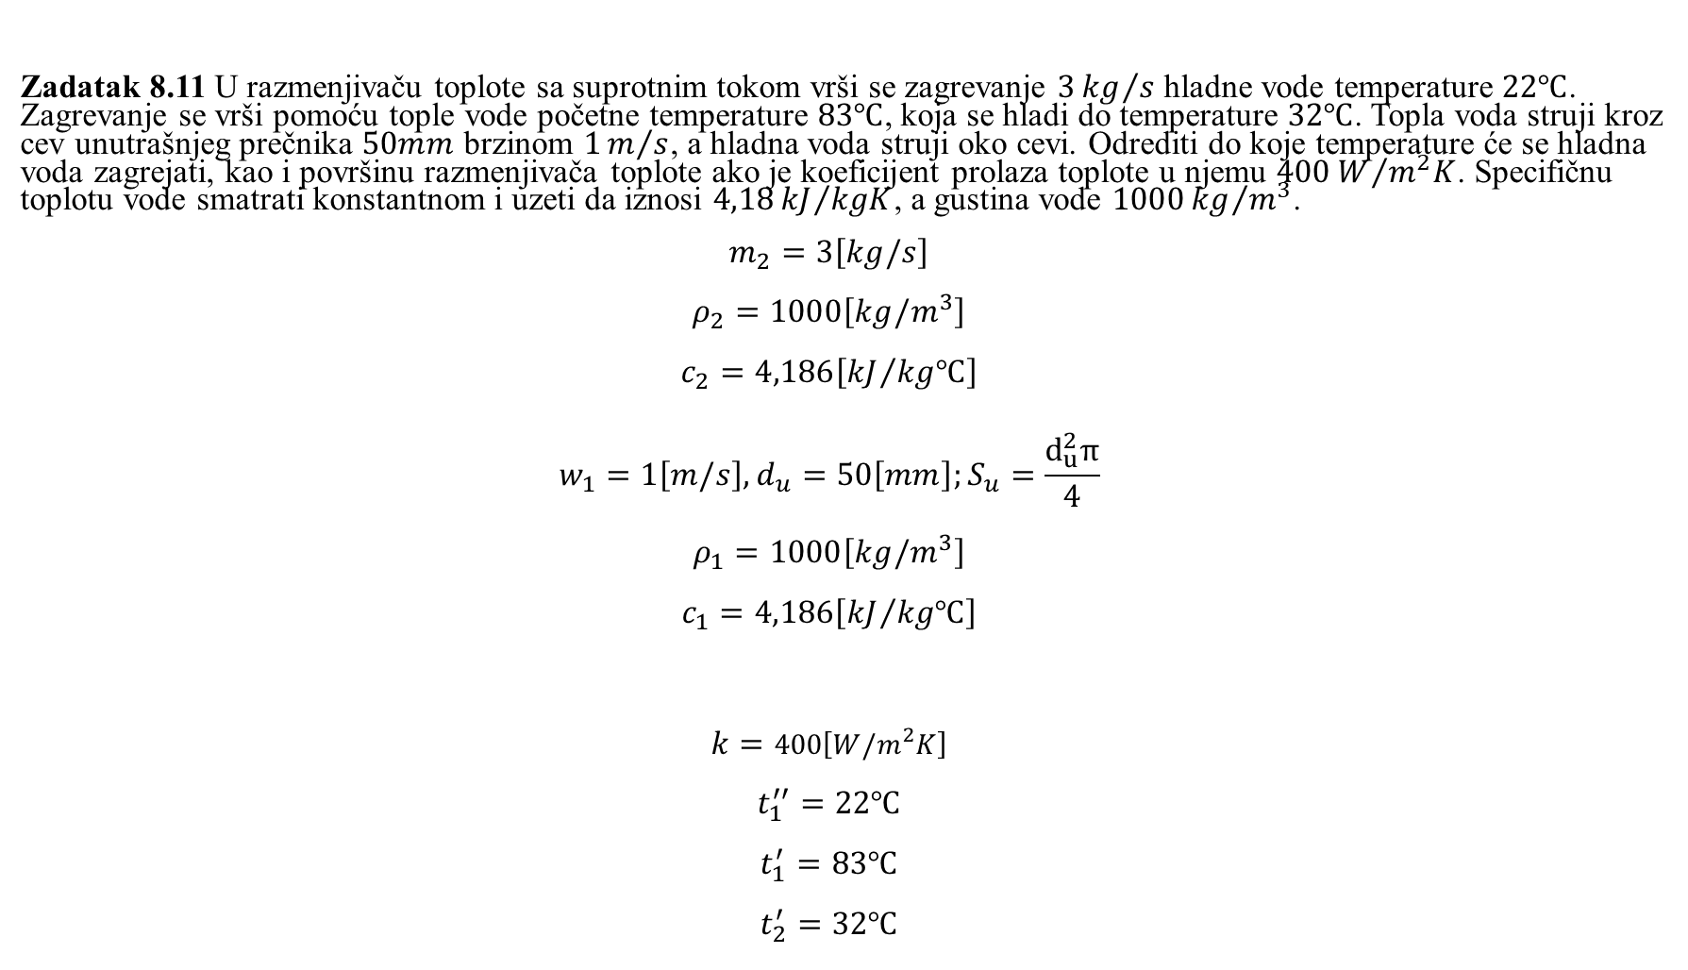
Zadatak 8.11 U razmenjivaču toplote sa suprotnim tokom vrši se zagrevanje $3{kg}/s$ hladne vode temperature $22℃$. Zagrevanje se vrši pomoću tople vode početne temperature $83℃$, koja se hladi do temperature $32℃$. Topla voda struji kroz cev unutrašnjeg prečnika $50mm$ brzinom $1m/s$, a hladna voda struji oko cevi. Odrediti do koje temperature će se hladna voda zagrejati, kao i površinu razmenjivača toplote ako je koeficijent prolaza toplote u njemu $400W/{m^{2}K}$. Specifičnu toplotu vode smatrati konstantnom i uzeti da iznosi $4,18{kJ}/{kgK}$, a gustina vode $1000{kg}/{m^{3}}$.
$$m_{2}=3\left[kg/s\right]$$
$$ρ_{2}=1000\left[kg/m^{3}\right]$$
$$c_{2}=4,186\left[{kJ}/{kg℃}\right]$$
$$w_{1}=1\left[m/s\right], d_{u}=50\left[mm\right];S_{u}=\frac{d_{u}^{2}π}{4}$$
$$ρ_{1}=1000\left[kg/m^{3}\right]$$
$$c_{1}=4,186\left[{kJ}/{kg℃}\right]$$
$$k=400\left[W/m^{2}K\right]$$
$$t_{1}^{′′}=22℃$$
$$t_{1}^{′}=83℃$$
$$t_{2}^{′}=32℃$$

Slide 13
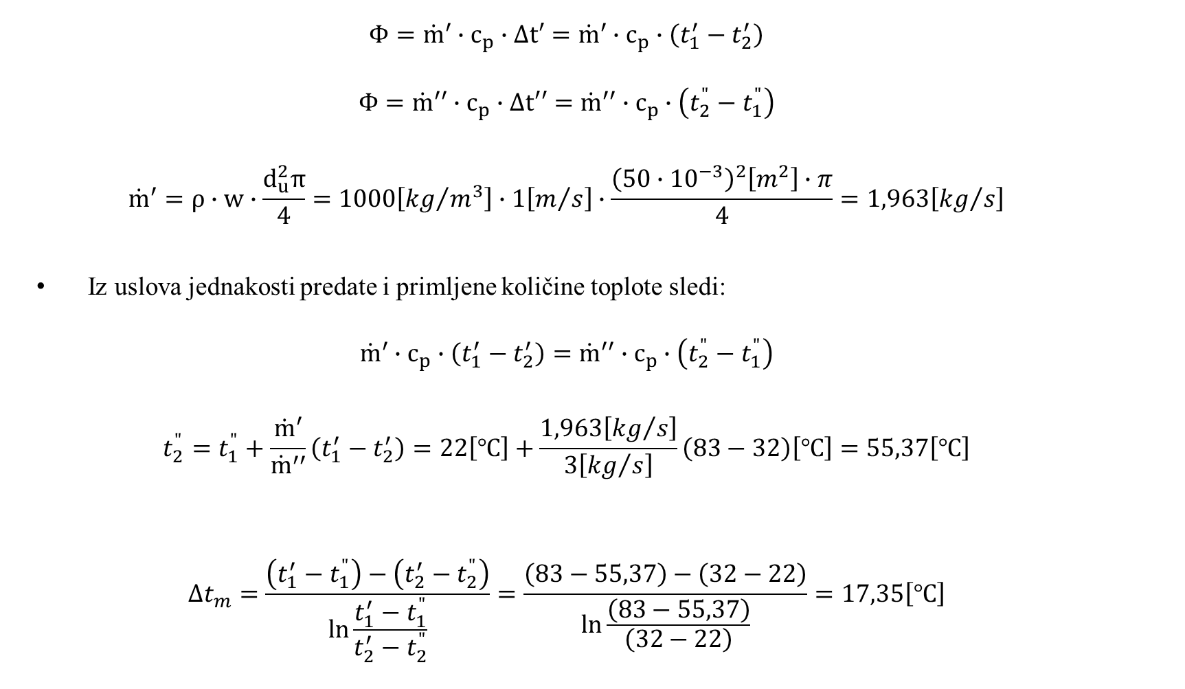
$$Φ={\dot{m}}^{′}∙c_{p}∙∆t′={\dot{m}}^{′}∙c_{p}∙\left(t_{1}^{′}−t_{2}^{′}\right)$$
$$Φ={\dot{m}}^{′′}∙c_{p}∙∆t′′={\dot{m}}^{′′}∙c_{p}∙\left(t_{2}^{"}−t_{1}^{"}\right)$$
$${\dot{m}}^{′}=ρ∙w∙\frac{d_{u}^{2}π}{4}=1000\left[{kg}/{m^{3}}\right]∙1\left[m/s\right]∙\frac{{\left(50∙{10}^{−3}\right)}^{2}\left[m^{2}\right]∙π}{4}=1,963\left[{kg}/s\right]$$
Iz uslova jednakosti predate i primljene količine toplote sledi:
$${\dot{m}}^{′}∙c_{p}∙\left(t_{1}^{′}−t_{2}^{′}\right)={\dot{m}}^{′′}∙c_{p}∙\left(t_{2}^{"}−t_{1}^{"}\right)$$
$$t_{2}^{"}=t_{1}^{"}+\frac{{\dot{m}}^{′}}{{\dot{m}}^{′′}}\left(t_{1}^{′}−t_{2}^{′}\right)=22\left[℃\right]+\frac{1,963\left[{kg}/s\right]}{3\left[{kg}/s\right]}\left(83−32\right)\left[℃\right]=55,37\left[℃\right]$$
$$∆t_{m}=\frac{\left(t_{1}^{′}−t_{1}^{"}\right)−\left(t_{2}^{′}−t_{2}^{"}\right)}{\ln{\frac{t_{1}^{′}−t_{1}^{"}}{t_{2}^{′}−t_{2}^{"}}}}=\frac{\left(83−55,37\right)−\left(32−22\right)}{\ln{\frac{\left(83−55,37\right)}{\left(32−22\right)}}}=17,35\left[℃\right]$$

Slide 14

$$Φ={\dot{m}}^{′}∙c_{p}∙∆t′$$
$$Φ={\dot{m}}^{′}∙c_{p}∙\left(t_{1}^{′}−t_{2}^{′}\right)=1,963\left[{kg}/s\right]∙4,186{kJ}/{kgK}$$
$$Φ={\dot{m}}^{′}∙c_{p}∙\left(t_{1}^{′}−t_{2}^{′}\right)=1,963\left[{kg}/s\right]∙4,186{kJ}/{kgK}\left(83−32\right)\left[℃\right]=418,47\left[kW\right]$$
$$Φ=k∙S∙∆t_{m}$$
$$S=\frac{Φ}{k∙∆t_{m}}=\frac{418,47∙{10}^{3}\left[W\right]}{400\left[W/{m^{2}K}\right]∙17,35\left[℃\right]}=60,3\left[m^{2}\right]$$

